Slide 1
Learning Python
The vast and lawless programming language

Slide 2

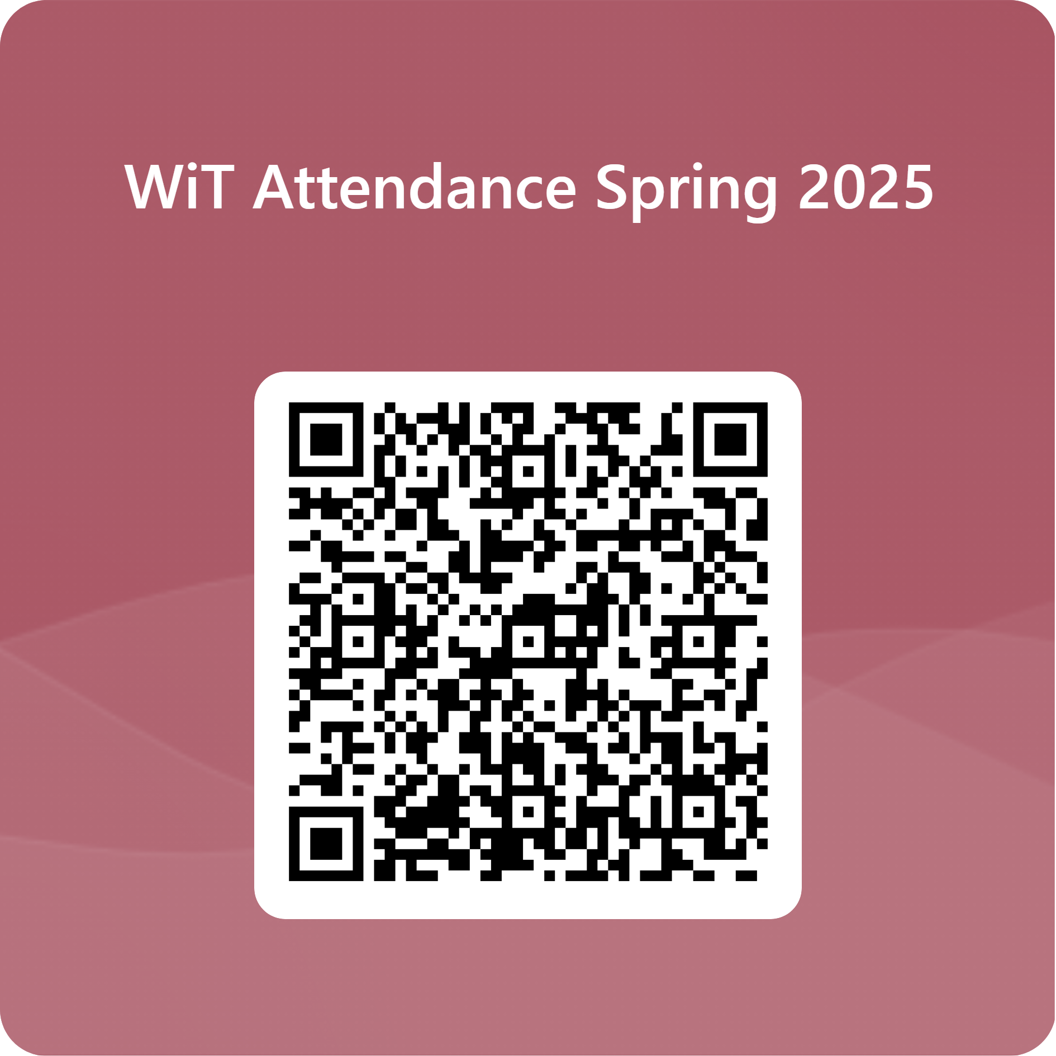

Slide 3
TABLE OF CONTENTS
01
02
03
04
FACTS ABOUT PYTHON
USES OF PYTHON
Why should you care?
When and where is it used?
VAST AND LAWLESS?
START LEARNING
What makes it unique?
Let’s take a look at python

Slide 4

guido van rossum
THE CREATOR OF PYTHON
Created Python in the late 1980s as a hobby project, later releasing it

Slide 5
FACTS ABOUT PYTHON
COMPILER
SOURCE
SIMPLE
Python uses a interpreter instead of a compiler. (Is translated line by line vs as entire program)
It’s free and open source. You can download it for your own use!
Python is a simple and readable language
Notes:
Python is an interpreted language, which means it does not require compilation, which makes debugging faster and easier.

Slide 6
ALSO, ITS GROWING

Slide 7
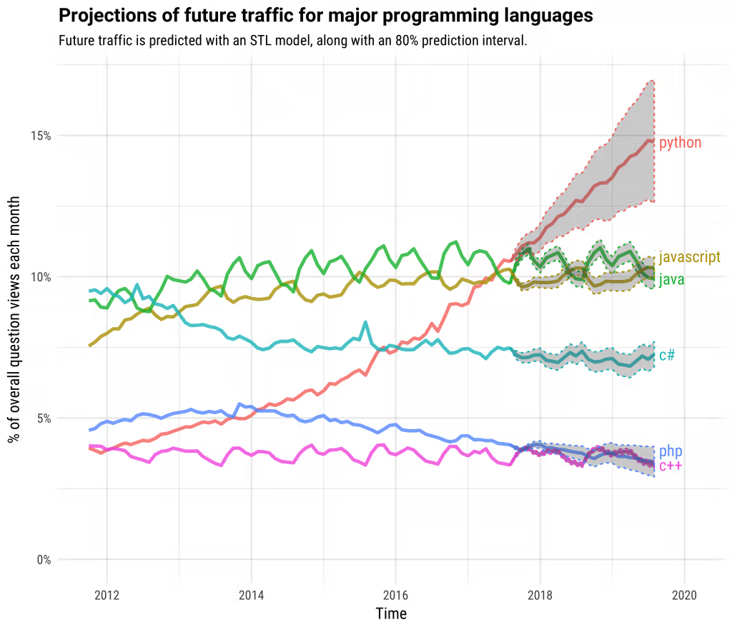

Slide 8
What is Python used for?
Basically…
Lots.

Slide 9
COMMON USES
Data
Data analytics, data visualization, calculations
AI
Machine learning and AI
Automation
Writing scripts to for file management, system administration.
Development
Web servers, building and deploying, testing

Slide 10
VAST AND LAWLESS?

Slide 11
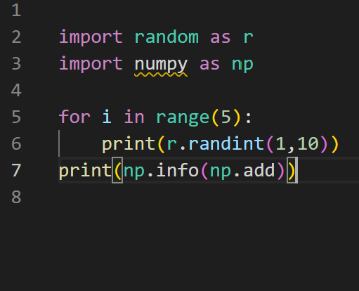
LIBRARIES
MAKE PYTHON VAST
incorporate ready-made functions and tools into their Python programs without having to write the code from scratch

Slide 12
DATA ANALYTICS
DATA VISUALIZATION
Pandas
  Data gathering
  Data cleaning
  Calculations
Numpy
  Data manipulation
  Fast calculations
Scipy
  Mathematical computing
Matplot
  Basic Graphing
Seaborn
  Built on top of Matplot
  More graphing!

Slide 13
MACHINE LEARNING AND AI
Scikit-Learn
  Predict data
LightGBM
XGBoost
CatBoost
PyCaret
PyTorch
TensorFlow

Slide 14
WEB FRAMEWORKS
FLASK
DJANGO
FASTAPI
Good for small website - projects, APIs, small services
Good for complex websites - with authentication, database, admin built in
Great for making APIs

Slide 15
COMPARED TO JAVA,
PYTHON SEEMS LAWLESS

Slide 16
JAVA
class HelloWorld {
public static void main(String[] args) {
System.out.println("Hello, World!");
}
}

Slide 17
PYTHON
print(‘Hello, World!’)
Notes:
Main function is like the entry point of a program. However, Python interpreter runs the code right from the first line. The execution of the code starts from the starting line and goes line by line.
Print statement is much more simple
Just start

Slide 18
JAVA
PYTHON
int number = 10;
number = 10
Notes:
Notice?
Declaring data type - The type of a variable is inferred at runtime based on the value assigned to it
Semicolon - don’t need it at end of lines. Just hit enter and make a new line

Slide 19
PYTHON
number = 10
Can I set number to ‘hi’?
Notes:
Lawless.
Declaring data type - The type of a variable is inferred at runtime based on the value assigned to it

Slide 20
JAVA
public class Main {
// Define the function
public static void myFunction() {
System.out.println("Hello from a function");
}
public static void main(String[] args) {
// Call the function
myFunction();
}
}

Slide 21
PYTHON
def my_function():
print("Hello from a function")
my_function()
Notes:
Differences you notice?
No curly brackets. Python use indentation to structure the code
Def = keyword to define a function. Def function_name():

Slide 22
JAVA
if (x > 0) {
System.out.println("Positive number");
} else {
System.out.println("Not positive");
}

Slide 23
PYTHON
if x > 0:
print("Positive number")
else:
print("Not positive")
Notes:
No curly brackets. Python use indentation to structure the code
Don’t need parentheses around the expression for the if statement
Colab: run it, change x to 0, to 5

Slide 24
PYTHON
for i in range(start, end (not included), step):
print(i)
#can you print 0 - 10
for i in range (11):
print(i)
#can you print 5 - 10
for i in range (5, 11):
print(i)
#can you print 6, 8, 10
for i in range (6, 11, 22):
print(i)

Slide 25
JAVA
// Declaring and initializing an array in one line
int[] intArray = {1, 2, 3, 4, 5};
// Accessing array elements
int firstElement = intArray[0]; // firstElement will be 1
Notes:
Array in Java

Slide 26
PYTHON
# Declaring and initializing a list in one line
list = [1, 2, 3, 4, 5]
# Accessing list elements
first_element = list[0]
# first_element will be 1
Notes:
List in python

Slide 27
PYTHON
Python also has tuples, sets, and dictionaries
#List items are ordered, changeable, and allow duplicate values.
#Tuple items are ordered, unchangeable, and allow duplicate values.
#Set items are unordered and do not allow duplicate values.
#Dictionary items are ordered and do not allow duplicates keys.
Notes:
List in python

Slide 28
PYTHON
Let's go back to our list
#how to access elements in a list?
list[index]
list[start index : end index]
Notes:
No! Lawless

Slide 29
PYTHON
Let's go back to our list
#do lists have to be of the same data type?
list = [1, 2, 3, 4, 5]
Notes:
No! Lawless

Slide 30
PYTHON
class Person:
def __init__(self, name, age):
self.name = name
self.age = age
def greet(self):
print(f"Hello, my name is {self.name} and I am {self.age} years old.")
Notes:
Def __init__ is the constructor method. Initialies name and age
Self is the instance of the class. Aka the unique object. Like this keyword in java. In python, you have to use it!

Slide 31
WANT MORE PYTHON?
Come back next week!

Slide 32
PYTHON AT CMU
CPS190
CPS191
Intro to python
Python 2
CPS280S
Elective for CPS majors. Also intro to python (gets into machine learning and data analytics / visualization
CPS420
Use python for web servers and APIs
Notes:
Any more?

Slide 33
YOU CAN ALSO LEARN ONLINE!
https://www.w3schools.com/python/default.asp
Notes:
Can find lists of beginner projects in python (or ask Chat as edom would say)

